Slide 1







Mesoscale Modeling of Hurricane Norbert Moisture Surge and AZ Flooding
Jennie Halverson, Dante Tabarracci, and Dorothea Ivanova
Department of Applied Aviation Sciences
Embry-Riddle Aeronautical University, Prescott, Arizona

Slide 2
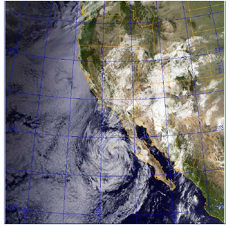
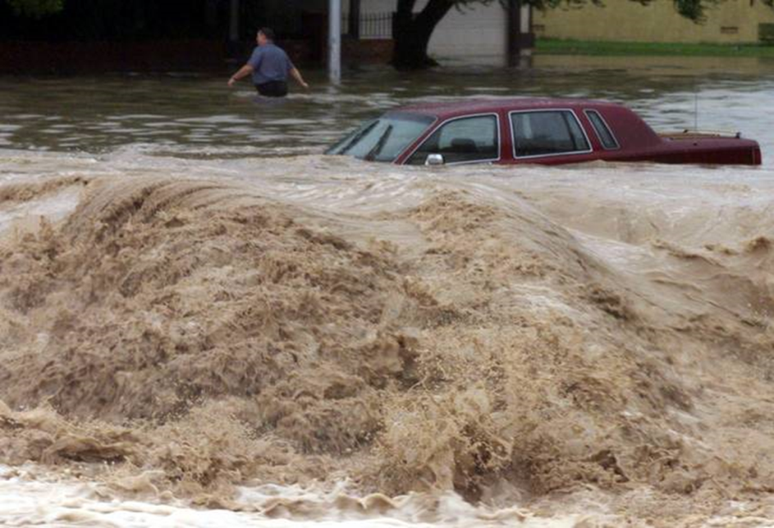
Objective
To more accurately predict major surges and flooding events in AZ using…
Weather Research Forecasting Model (WRF)
  Sea Surface Temperature (SST) fluctuation
  Tropical Cyclone Development
  Thunderstorm Development in Northwestern Mexico
Visible / IR composite satellite photo of the western US, courtesy of the Naval Research Laboratory. Taken at 8:30 am MST on 9/8/2014.
Severe flooding in Chandler, AZ as a result of 9/8/14 moisture surge.

Slide 3
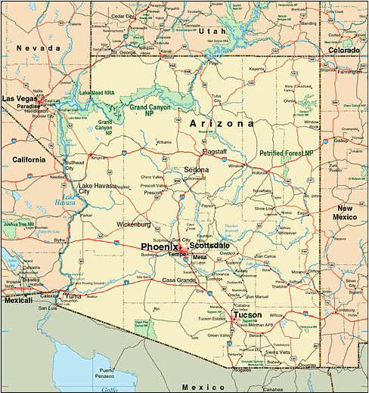
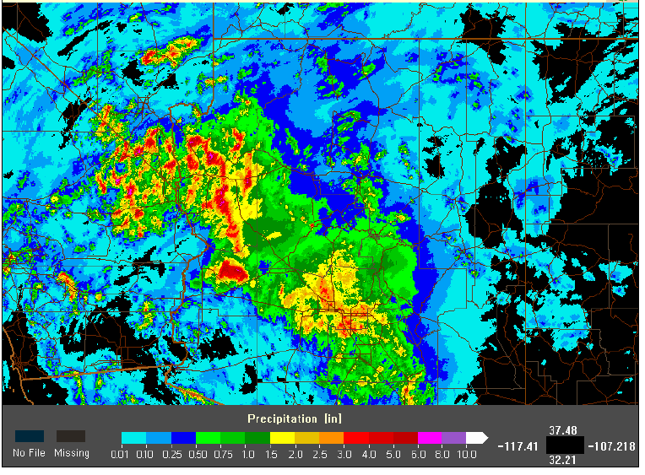
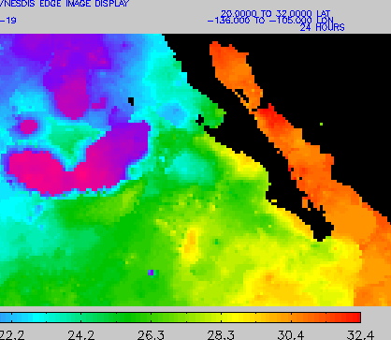
WRF setup 6 Sep - 9 Sep
3 Nested Domains: Red – PHX area, Blue – Chandler area, Black – Tucson area
NOAA/NESDIS display of SSTs Sep 8-Sep 9 in Gulf of California.
Overall SW radar product, 24 hour precipitation accumulation ending at 1200 MST Sep 8 from the NWS.

Slide 4
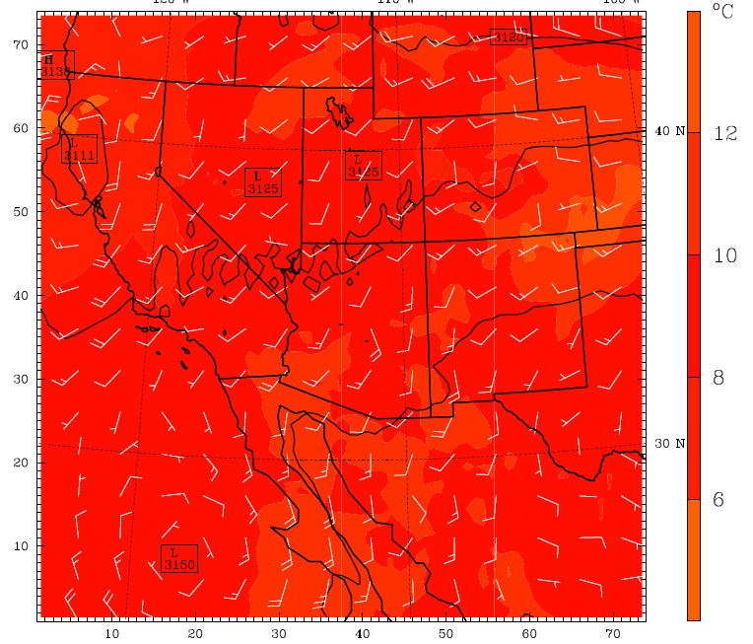
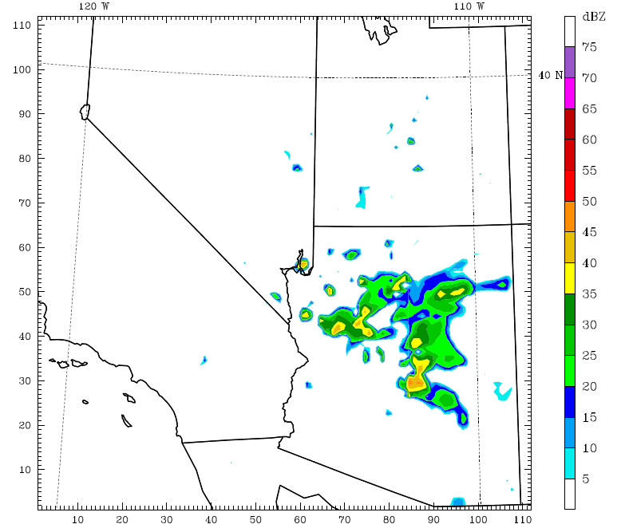
Wind Patterns and Predicted Propagation
WRF model output of temperatures, 700mb height contours, and wind barbs for 1800Z 8 Sep. Warm moist air propagated to the north feeding storms.
WRF model predicted radar output for 1800Z 8 Sep, right at time of the flood.

Slide 5
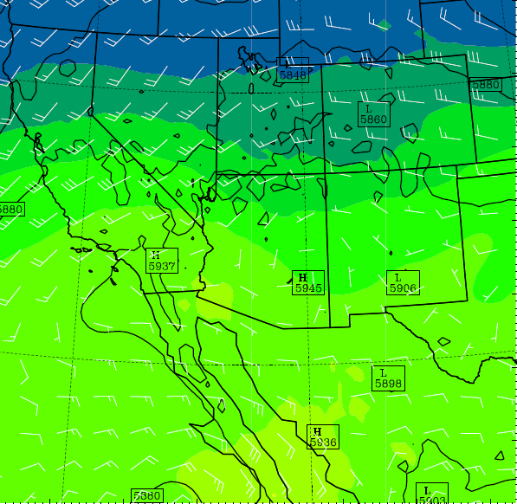
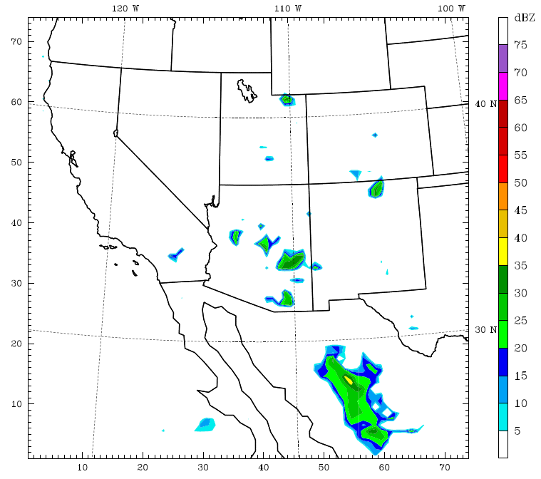
Major Surge Requirements
Low pressure over AZ
TS activity over NW Mexico
  - Precip cools air
  - Counter- rotating pressure systems
  - Severe trigger
(Hurricane Norbert)
500 mb WRF output of low pressure systems over N Utah and Wyoming indicating CCW circulation pattern 1800Z 6 Sep
WRF radar output showing some convection and storm formation/precipitation over Sierra Madres 0000Z 7 Sep

Slide 6
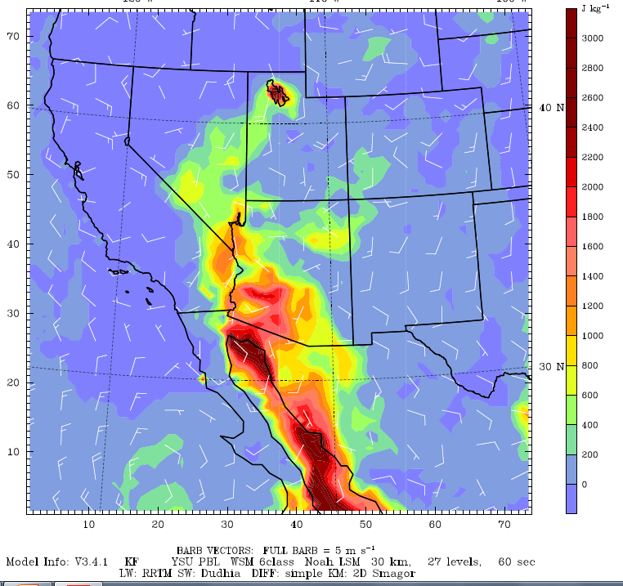
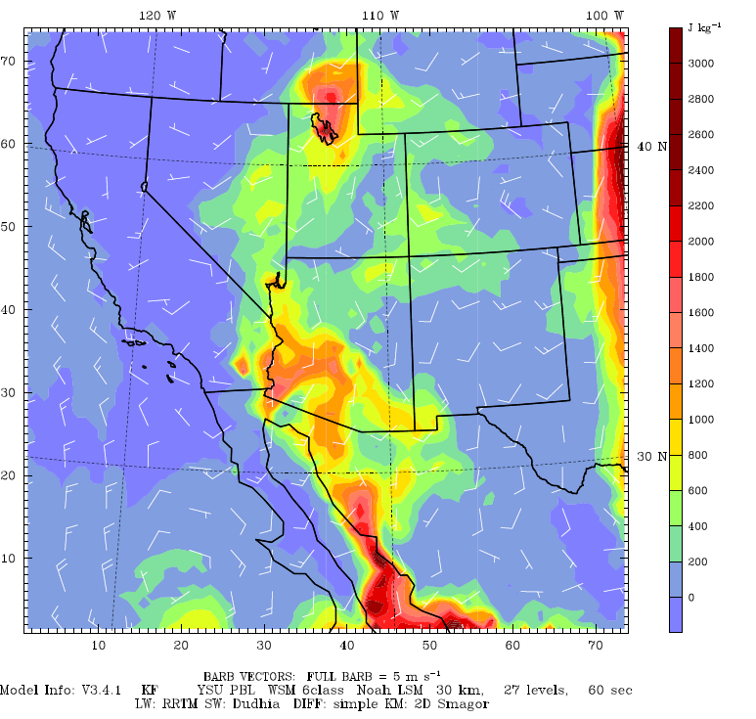
Major Surge Requirements Cont’d…
WRF output for CAPE values over NW Mexico and AZ at 0600Z on 8 Sep. Moderate CAPE values are still seen over Sierra Madres.
WRF output for CAPE values over NW Mexico and AZ at 1800Z on 8 Sep at the time of the flooding. CAPE propagated NNE and encompassed Tucson.

Slide 7
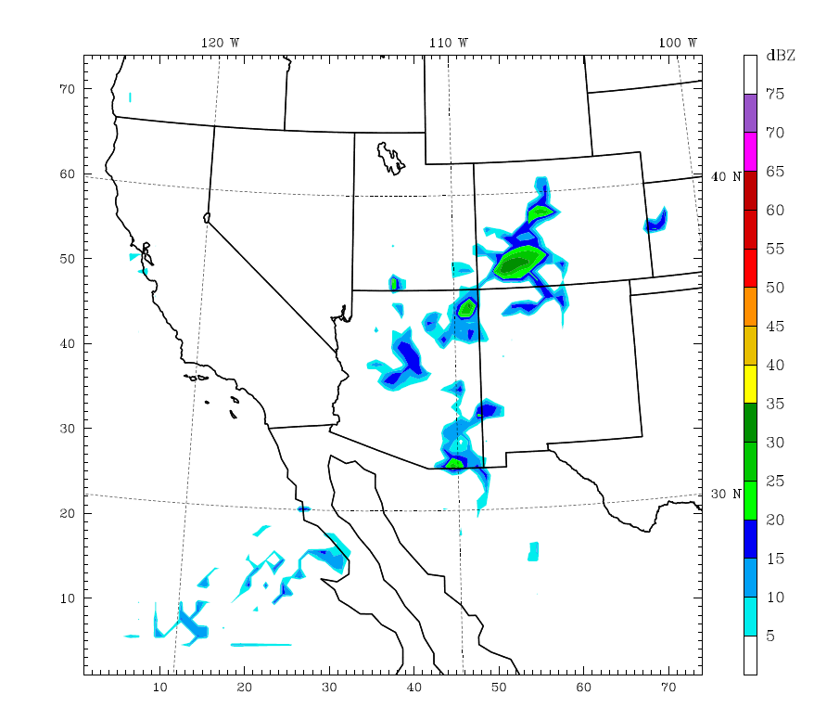
Verification of Precipitation intensity
Overall SW radar product, 24 hour precipitation accumulation ending at 1200 MST Sep 8 from the NWS.
What the WRF predicted for radar reflectivity at 1100 MST on Sep 8.
WRF output predicted rain would propagate over Tucson as well on 1200Z on 9 Sep.

Slide 8
Conclusions
A presence of a major surge event in the Gulf of Baja-California during the simulations period was detected and monitored by the group of Dr. Miguel Lavin from CISSESE –Encenada, Mexico’s Oceanographic Institute.
WRF accurately predicted events leading to the major surge – one cause of the severe flooding in Chandler, Phoenix, and Tucson.
Could slightly increase accuracy over Tucson the day of floods (8 Sep, 2014)
This shows us that the WRF is a valuable forecasting tool that can be used to predict similar major surge events in the future and predict their intensity and propagation.
halversj@my.erau.edu

